Slide 1
Topics in Data Science
Dimensionality Reduction
Lecture 16

Slide 2
Dimensionality reduction methods
If number of variables in a dataset is increased
More time to compute
More memory to store inputs and intermediate results
More complicated explanations (knowledge from learning)
  Regression from 10 vs. 2 parameters
No simple visualization
  2D vs. 10D graph
Need much more data (curse of dimensionality)
  1M of 1-d inputs is not equal to 1 input of dimension 1M
Some features (dimensions) bear little or nor useful information (e.g. color of hair for a car selection)
  Can drop some features
  Have to estimate which features can be dropped from data

Slide 3
Dimensionality reduction methods
Dimensionality reduction is another important unsupervised learning problem with many applications.
Dimensionality reduction methods aim to simplify complex datasets by reducing the number of features while preserving essential information. Common techniques include
Principal Component Analysis (PCA)
Linear Discriminant Analysis (LDA)
Independent Component Analysis (ICA)

Slide 4
The Curse of Dimensionality
Dimensionality becomes a serious obstacle for the efficiency of most of the DM algorithms.
As the number of dimensions increase, the sample size needs to increase exponentially in order to have an effective estimate of multivariate densities.

Slide 5
Principal Component Analysis

Slide 6
Principal Component Analysis
Dimensionality reduction method
  A way to simplify complex high-dimensional data
  Summarize data with a lower dimensional real valued vector with no to minimal loss of information
  PCA are formed as a linear combinations of the data which is used to preserve the information
  PCA- the extraction of hidden predictive information from large database

Slide 7
Principal Component Analysis (PCA)
Unsupervised technique for extracting variance
structure from high dimensional datasets.
PCA is an orthogonal projection or transformation of the data into a (possibly lower dimensional) subspace so that the variance of the projected data is maximized.
The number of principal components is less than or equal to the number of original variables

Slide 8
Why it is called Principal Component Analysis?
PCA is a linear transformation that chooses a new coordinate system for the data set such that greatest variance by any projection of the data set comes to lie on the first axis (then called the first principal component)
It reduces the dimensions of a d-dimensional dataset by projecting it onto a (k)-dimensional subspace (where k<d) in order to increase the computational efficiency while retaining most of the information.
This transformation is defined in such a way that the first principal component has the largest possible variance and each succeeding component in turn has the next highest possible variance.

Slide 9
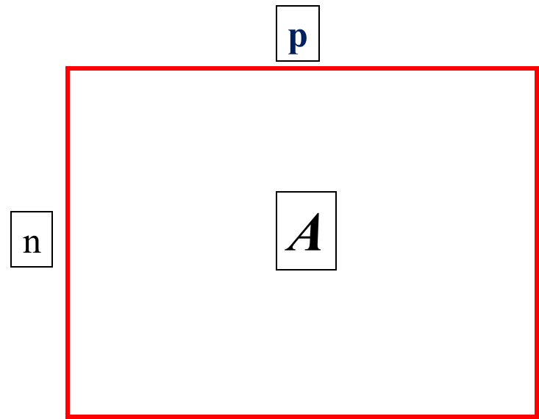
Data Reduction
summarization of data with many (p) variables by a smaller set of (k) variable derived (synthetic, composite) variables.
k
X
n

Slide 10
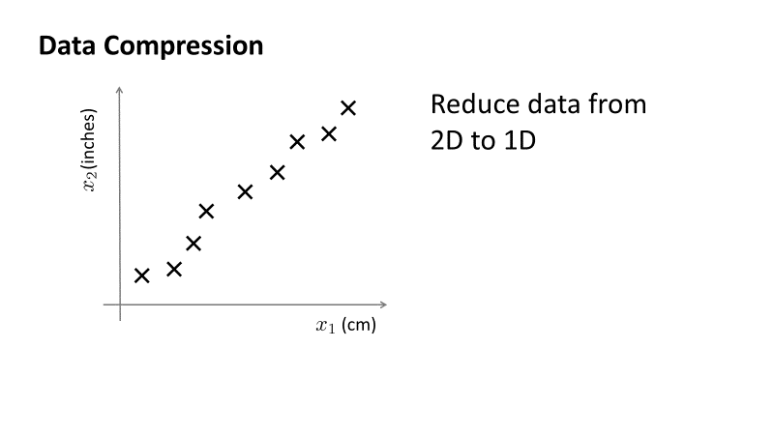
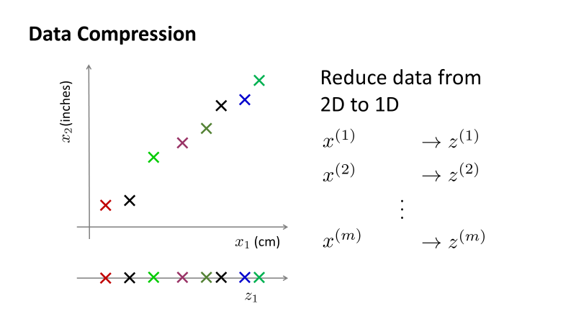

Slide 11
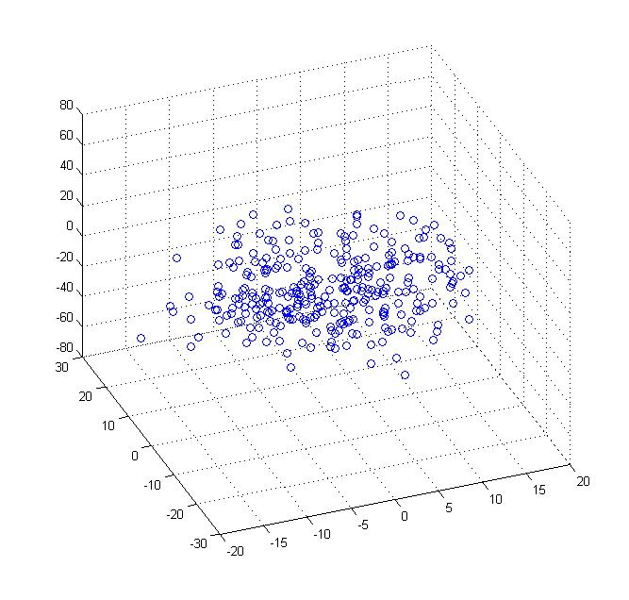
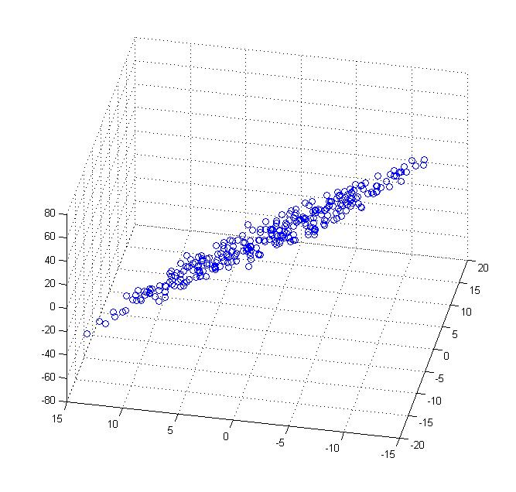
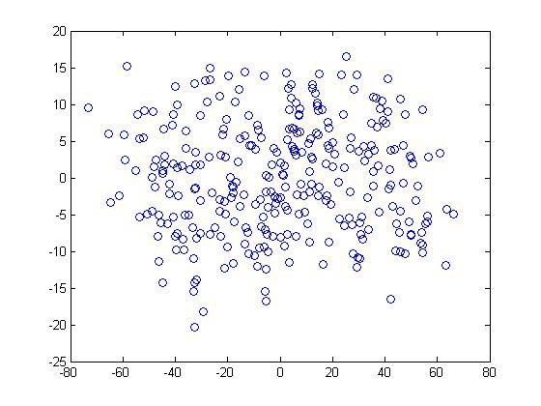





Data Compression
Reduce data from 3D to 2D
Notes:
Pca3d2d in lecture-slides/assets/pca/
Label axes

Slide 12
Principal Component Analysis
X2
Y1
Y2
x
x
x
x
x
x
x
x
x
x
x
x
x
x
x
Note: Y1 is the first eigen vector,
Y2 is the second. Y2 ignorable.
x
x
X1
x
x
x
Key observation:
variance = largest!
x
x
x
x
x

Slide 13
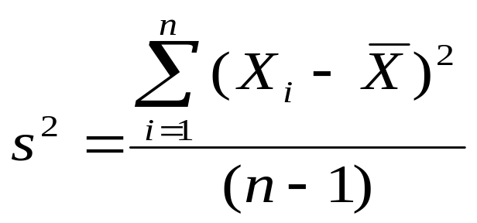
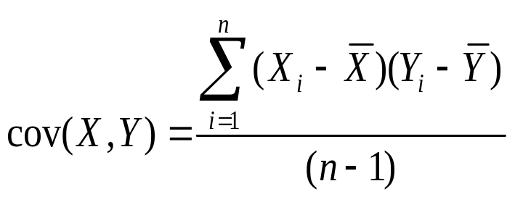
Principal Component Analysis
Question: how much spread is in the data along the axis? (distance to the mean for a single variable data)
Variance
Bivariate Data
Covariance: measures the correlation between X and Y
Cov(X,Y)=0: independent
Cov(X,Y)>0: move same direction
Cov(X,Y)<0: move opposite direction

Slide 14
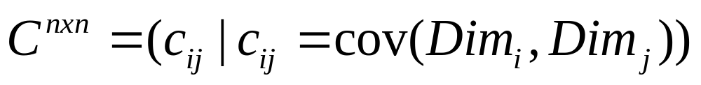
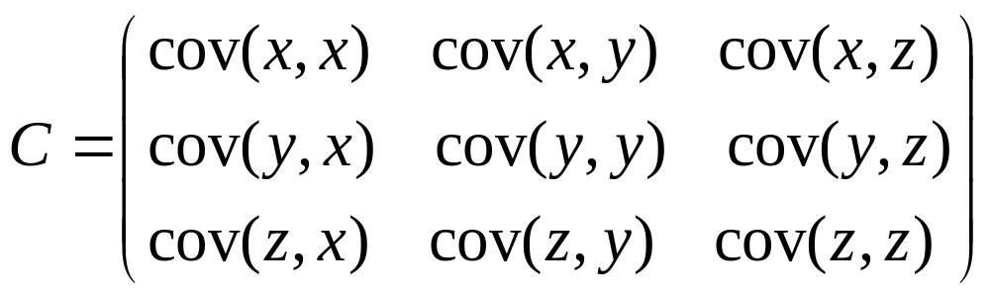
More than two attributes: covariance matrix
Contains covariance values between all possible dimensions (=attributes):
Example for three attributes (x,y,z):

Slide 15
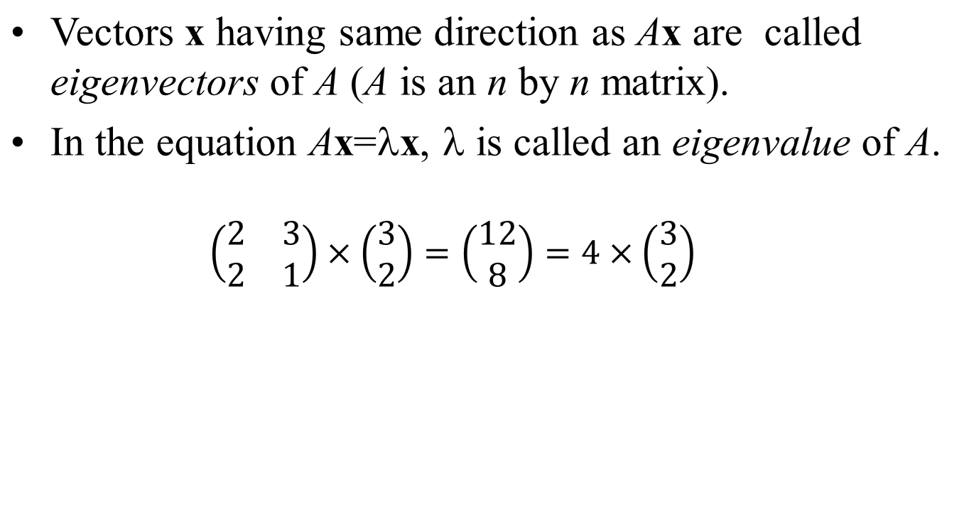
Eigenvalues & Eigenvectors

Slide 16
Eigenvalues & Eigenvectors
Ax=λx ⇔ (A-λI)x=0
How to calculate x and λ:
  Calculate det(A-λI), yields a polynomial (degree n)
  Determine roots to det(A-λI)=0, roots are eigenvalues λ
  Solve (A- λI) x=0 for each λ to obtain eigenvectors x

Slide 17
Computing Eigenvalues
Since x is required to be nonzero, the eigenvalues
must satisfy
det(A - λI) = 0
which is called the characteristic equation.
Solving it for values of λ gives the eigenvalues of matrix A.

Slide 18
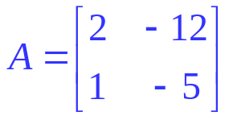
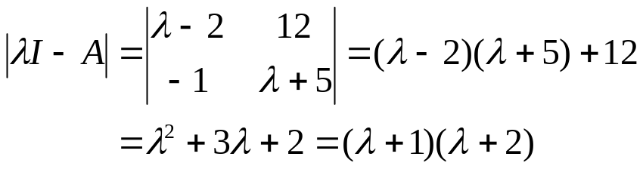
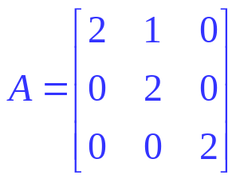
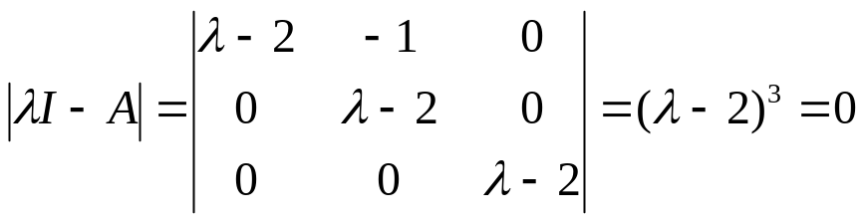
Computing Eigenvalues
Example : Find the eigenvalues of
two eigenvalues: −1, − 2
Note: The roots of the characteristic equation can be repeated. That is, λ₁ = λ₂ =…= λ_{k}. If that happens, the eigenvalue is said to be of multiplicity k.
Example : Find the eigenvalues of
λ = 2 is an eigenvalue of multiplicity 3.

Slide 19
Example:
1 -2 1 - λ -2
3 -4 3 -4 - λ
A = so A - λI =
det(A - λI) = (1 - λ)(-4 - λ) – (3)(-2)
= λ² + 3 λ + 2
Set λ² + 3 λ + 2 equal to 0
So the two values of λ are -1 and -2.

Slide 20
Finding the Eigenvectors
Once you have the eigenvalues, you can plug them into the equation Ax = λx to find the corresponding sets of eigenvectors x.
1 -2 x₁ = -1 x_{1 so}
3 -4 x₂ x₂
x₁ – 2x₂ = -x₁
3x₁ – 4x₂ = -x₂
These equations are not
independent. If you multiply
(2) by 2/3, you get (1).
2x₁ – 2x₂ = 0
3x₁ – 3x₂ = 0
The simplest form of (1) and (2) is x₁ - x₂ = 0, or just x₁ = x₂.

Slide 21
Since x₁ = x₂, we can represent all eigenvectors for
eigenvalue -1 as multiples of a simple basis vector:
E = t 1 , where t is a parameter.
1
So [1 1]^{T}, [4 4]^{T}, [3000 3000]^{T} are all possible eigenvectors
for eigenvalue -1.
For the second eigenvalue (-2) we get
1 -2 x₁ = -2 x_{1 so}
3 -4 x₂ x₂
x₁ – 2x₂ = -2x₁
3x₁ – 4x₂ = -2x₂
3x₁ – 2x₂ = 0
3x₁ – 2x₂ = 0
so eigenvectors are of the form t 2 .
3

Slide 22
Eigenvalues and Eigenvectors in R
> data=c(2,-12,1,-5)
> M=matrix(data, ncol=2, byrow=T)
> M
[,1] [,2]
[1,] 2 -12
[2,] 1 -5
> eigen(M)
eigen() decomposition
$values
[1] -2 -1
$vectors
[,1] [,2]
[1,] 0.9486833 0.9701425
[2,] 0.3162278 0.2425356
>

Slide 23
Eigenvector and Eigenvalue
Ax = λx
A: Square Matirx
λ: Eigenvector or characteristic vector
X: Eigenvalue or characteristic value
The zero vector can not be an eigenvector
The value zero can be eigenvalue

Slide 24
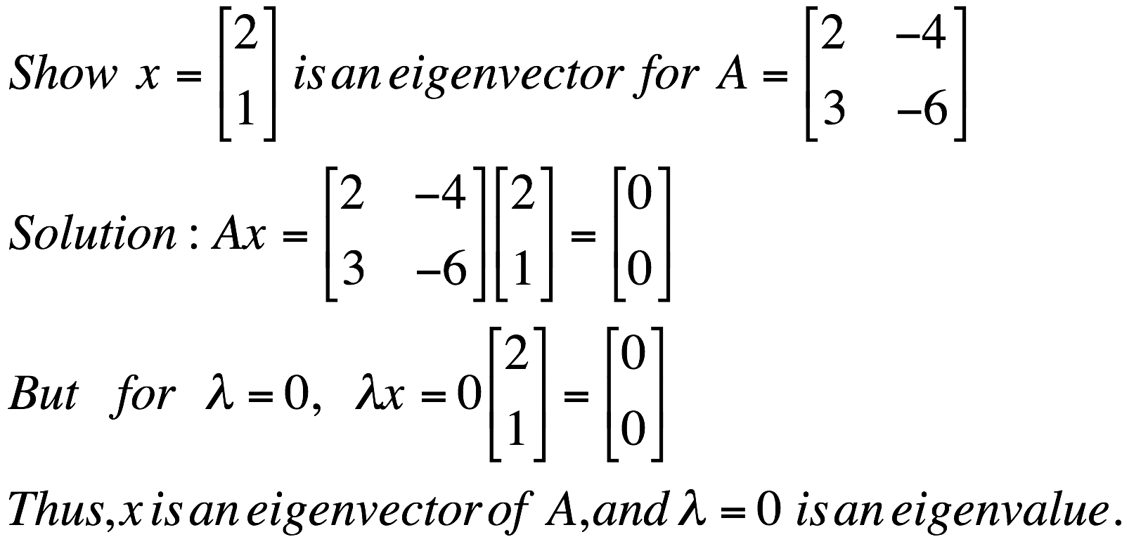
Eigenvector and Eigenvalue
Ax = λx
A: Square Matirx
λ: Eigenvector or characteristic vector
X: Eigenvalue or characteristic value
Example

Slide 25
Principal components
1. principal component (PC1)
  The eigenvalue with the largest absolute value will indicate that the data have the largest variance along its eigenvector, the direction along which there is greatest variation
2. principal component (PC2)
  the direction with maximum variation left in data, orthogonal to the PC1.
In general, only few directions manage to capture most of the variability in the data.

Slide 26

Steps of PCA
1. Let be the mean vector (taking the mean of all rows)
2. Adjust the original data by the mean
  X’ = X –
3.Compute the covariance matrix C of adjusted X
4. Find the eigenvectors and eigenvalues of C.
5. For matrix C, vectors e (=column vector) having same direction as Ce :
  eigenvectors of C is e such that Ce=λe,
  λ is called an eigenvalue of C.
6. Ce=λe ⇔ (C-λI)e=0
  We will use R to compute eigen value and eigen vector

Slide 27
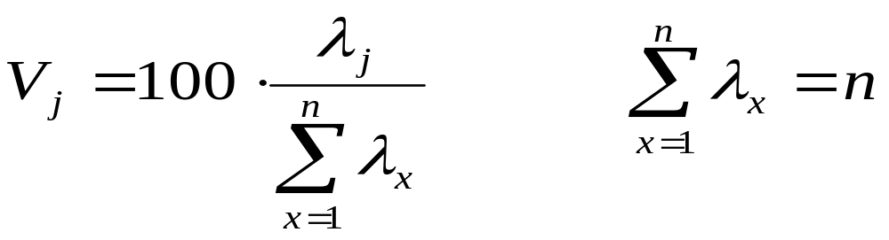
Eigenvalues
Calculate eigenvalues λ and eigenvectors x for covariance matrix:
  Eigenvalues λ_{j} are used for calculation of [% of total variance] (V_{j}) for each component j:

Slide 28
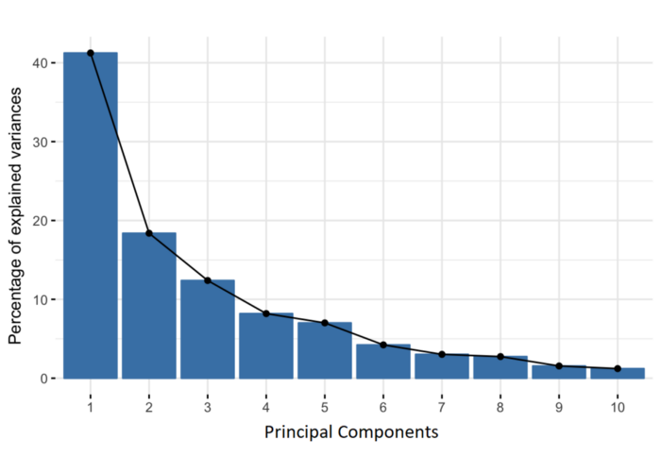
Principal components are new variables that are constructed as linear combinations or mixtures of the initial variables. These combinations are done in such a way that the new variables (i.e., principal components) are uncorrelated and most of the information within the initial variables is squeezed or compressed into the first components. So, the idea is 10-dimensional data gives you 10 principal components, but PCA tries to put maximum possible information in the first component, then maximum remaining information in the second and so on, until having something like shown in the scree plot below.

Slide 29
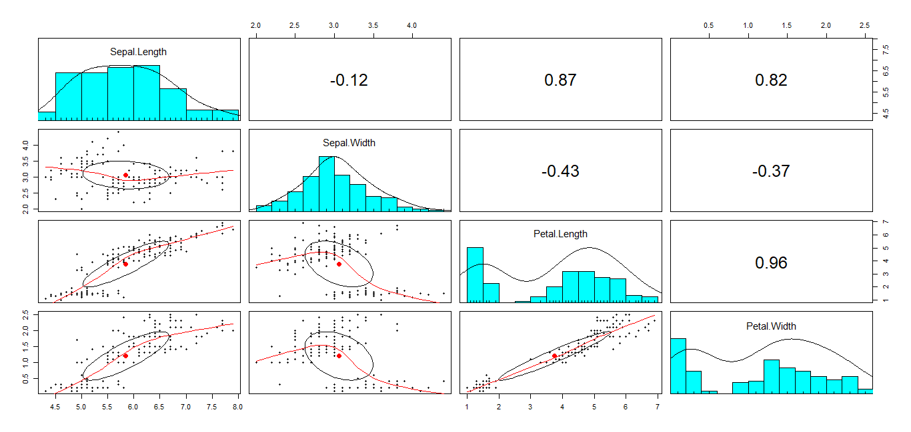
Example-Iris Data
> data(iris)
> dim(iris)
[1] 150 5
> library(ggplot2)
> library(psych)
> pairs.panels(iris[,-5])

Slide 30
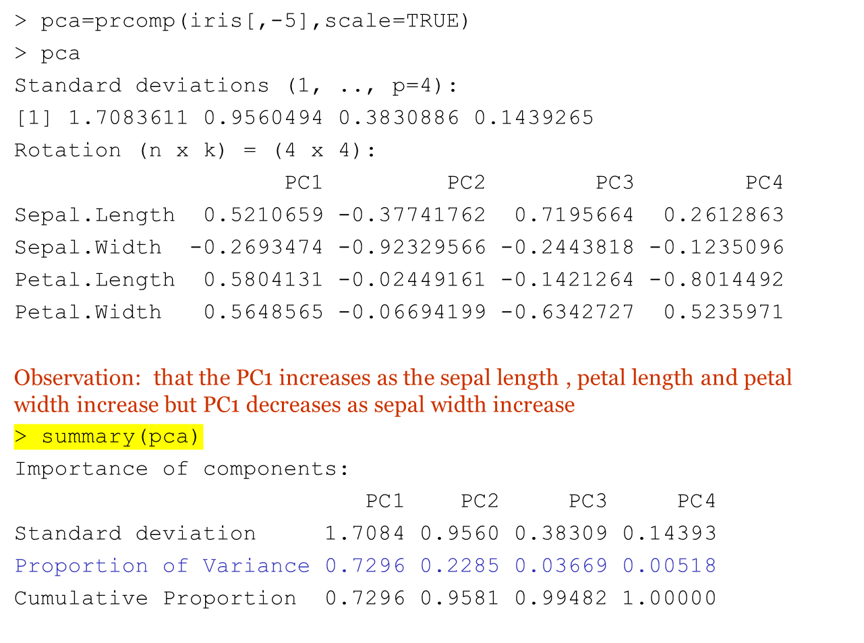
PCA –iris data

Slide 31
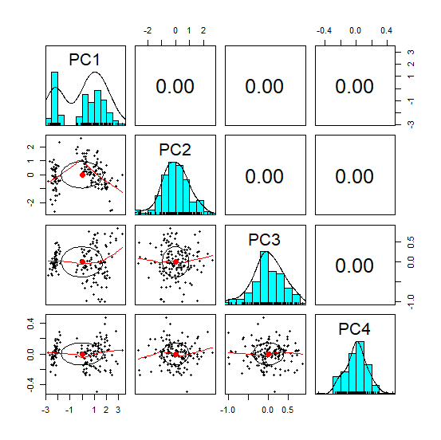
Pairs panel after transformation
> pairs.panels(pca$x)

Slide 32
PCA-iris data
> S=cov(scale(iris[,-5]))
> S
Sepal.Length Sepal.Width Petal.Length Petal.Width
Sepal.Length 1.0000000 -0.1175698 0.8717538 0.8179411
Sepal.Width -0.1175698 1.0000000 -0.4284401 -0.3661259
Petal.Length 0.8717538 -0.4284401 1.0000000 0.9628654
Petal.Width 0.8179411 -0.3661259 0.9628654 1.0000000
> seigen=eigen(S)
> seigen
eigen() decomposition
$values
[1] 2.91849782 0.91403047 0.14675688 0.02071484
$vectors
[,1] [,2] [,3] [,4]
[1,] 0.5210659 -0.37741762 0.7195664 0.2612863
[2,] -0.2693474 -0.92329566 -0.2443818 -0.1235096
[3,] 0.5804131 -0.02449161 -0.1421264 -0.8014492
[4,] 0.5648565 -0.06694199 -0.6342727 0.5235971
> seigen$value/sum(seigen$value)
[1] 0.729624454 0.228507618 0.036689219 0.005178709
>

Slide 33
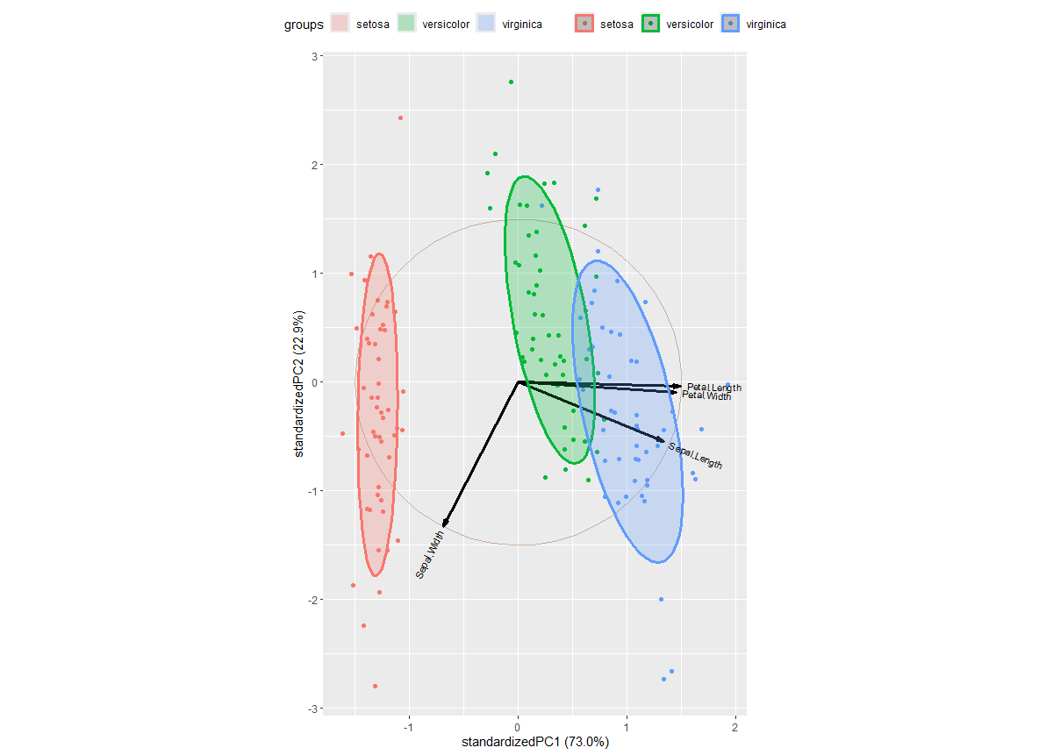
PCA-IRIS data
pca=prcomp(iris[,-5],center=TRUE,scale=TRUE)
pcasummary(pca)
library(devtools)
library(ggbiplot)
g=ggbiplot(pca, groups=iris$Species, ellipse = TRUE, circle=TRUE, ellipse.prob = 0.68)
g<-g+scale_color_discrete(name="")
g<-g+theme(legend.direction ="horizontal",legend.position= "top")
print(g)

Slide 34
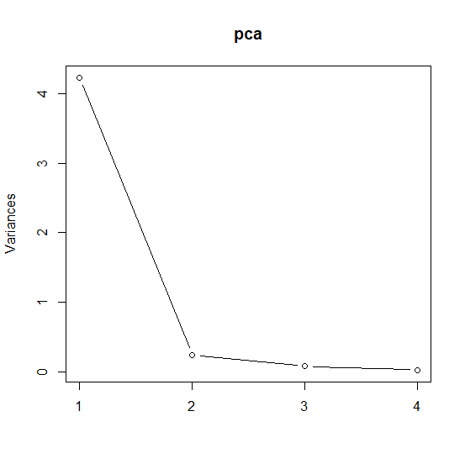
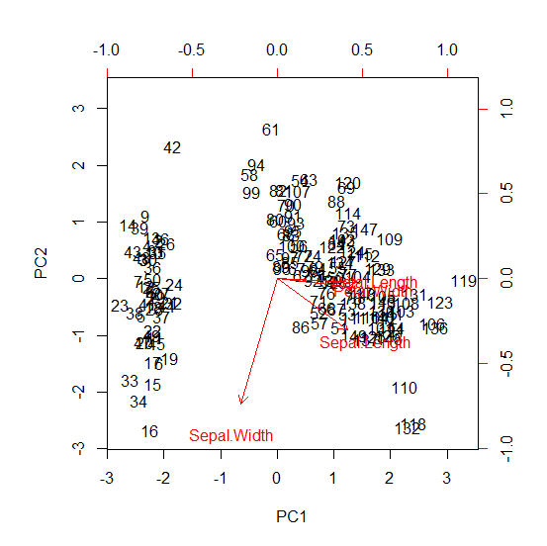
Scree plot and biplot
> plot(pca,type="l")
> biplot(pca,scale=0)
In the biplot the number indicate the item(observation) number. Each point is plotted with its value for PC1 and PC2 . The red arrows represent the eigen vector for each variable in the data frame. As the observation has higher value for PC1 it has a lower Sepal width and higher petal length, petal width and petal length. As the observation has higher value of PC2 it has lower sepal width , slightly lower sepal length and no real difference between petal length and petal width

Slide 35
Classification using PC1 and PC2
> iris2=cbind(iris,pca$x[,1:2])
> head(iris2)
Sepal.Length Sepal.Width Petal.Length Petal.Width Species PC1 PC2
1 5.1 3.5 1.4 0.2 setosa -2.257141 -0.4784238
2 4.9 3.0 1.4 0.2 setosa -2.074013 0.6718827
3 4.7 3.2 1.3 0.2 setosa -2.356335 0.3407664
4 4.6 3.1 1.5 0.2 setosa -2.291707 0.5953999
5 5.0 3.6 1.4 0.2 setosa -2.381863 -0.6446757
6 5.4 3.9 1.7 0.4 setosa -2.068701 -1.4842053
ggplot(iris2,aes(PC1,PC2, col=Species, fill=Species))+ stat_ellipse(geom="polygon", col="black", alpha=0.5)+ geom_point(shape=19)

Slide 36
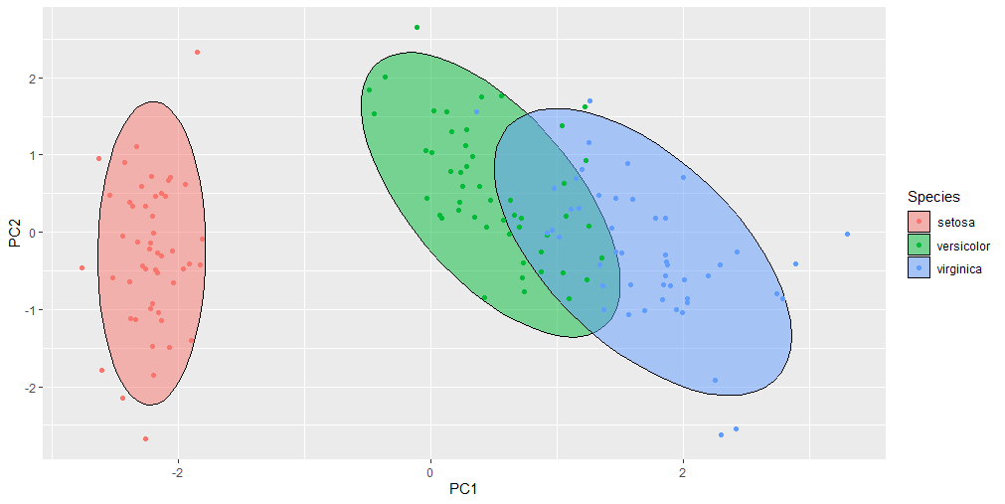

Slide 37
Principal Component Regression
Running some form of regression on an input dataset that exhibits strong multicollinearity can cause unstable regression coefficients, because the regression algorithm can somewhat arbitrarily attribute importance to each predictor in a set of collinear predictors.
Principal Component Regression (PCR) is often used to 'solve' this problem by describing the input dataset according to a set of orthogonal axes - the principal components - which thus do not exhibit multicollinearity.

Slide 38
PCR-Principal Component Regression
Rotate coordinate systems to create an orthogonal set of new regressor variables
  – Each new variable (called a principal component) is a linear combination of the original variables
• Steps to do this:
  – Calculate the correlation matrix of predictors
  – Find the eigenvalues and corresponding eigenvectors of the correlation matrix
  – Orthogonalize the design matrix by multiplying by a rotation matrix made up of the eigenvectors

Slide 39
PCR
Create a regression model using the new design matrix based on Principal components rather than X
• Frequently, some of the principal components will not be correlated with the response which be excluded from the model
• Since each PC is orthogonal to the others, a simple t-test of model coefficients can be used to keep or exclude model terms
– There is no multicollinearity

Slide 40
Example-PCR
>bodyfat<-read.csv("C:\\Users\\aryal\\BodyFatdata.csv")
>head(bodyfat)
>attach(bodyfat)
>model=lm( BodyFat~Weight +Chest +Abdomen + Hip +Thigh+ Biceps)
> library(car)
> vif(model)
Weight Chest Abdomen Hip Thigh Biceps
13.881301 8.437717 7.652470 11.048796 5.433204 2.916136
High value of vif indicates that the predictor variables are correlated, and multicollinearity is an issue
> library(psych)
> bodyfatx=bodyfat[,-1]
> pairs.panels(bodyfatx)
> bodyfatx.pca=prcomp(bodyfatx, center=TRUE, scale=True)
> plot(bodyfatx.pca, type="l") #scree plot
> box()
> summary(bodyfatx.pca)

Slide 41
Example-PCR
bodyfatx=bodyfat[,-1]
bodyfatx.pca=prcomp(bodyfatx, center=TRUE, scale=True)
bodyfat.pca=cbind(bodyfat[,1], data.frame(bodyfatx.pca$x))
colnames(bodyfat.pca)[1]="Bodyfat"
head(bodyfat.pca)
cor(bodyfat.pca)[,1]
bodyfat.pcr1=lm(Bodyfat~., data=bodyfat.pca)
summary(bodyfat.pcr1)
Getting back to to the original Variable
betas1=bodyfatx.pca$rotation%*%bodyfat.pcr1$coefficients[-1]
betas1

Slide 42
Dimension Reduction
“Residual” variation is information in A that is not retained in X
It is a balancing act between
  clarity of representation, ease of understanding
  oversimplification: loss of important or relevant information.

Slide 43
Principal Component Analysis (PCA)
probably the most widely-used and well-known of the “standard” multivariate methods
invented by Pearson (1901) and Hotelling (1933)
first applied in ecology by Goodall (1954) under the name “factor analysis” (“principal factor analysis” is a synonym of PCA).

Slide 44
Principal Component Analysis (PCA)
  It takes a data matrix of n objects by p variables, which may be correlated, and summarizes it by uncorrelated axes (principal components or principal axes) that are linear combinations of the original p variables
  the first k components display as much as possible of the variation among objects.

Slide 45
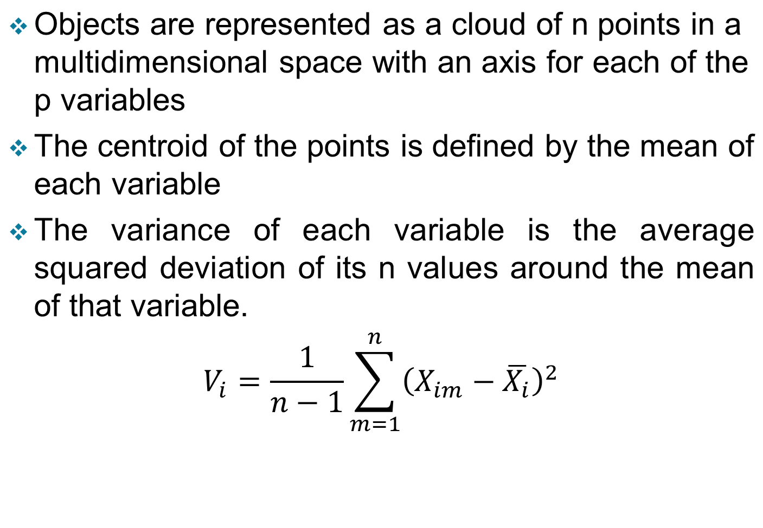
Geometric Rationale of PCA

Slide 46
Geometric Rationale of PCA
The objective of PCA is to rigidly rotate the axes of this p-dimensional space to new positions (principal axes) that have the following properties:
  ordered such that principal axis 1 has the highest variance, axis 2 has the next highest variance, .... and axis p has the lowest variance
  covariance among each pair of the principal axes is zero (the principal axes are uncorrelated).

Slide 47
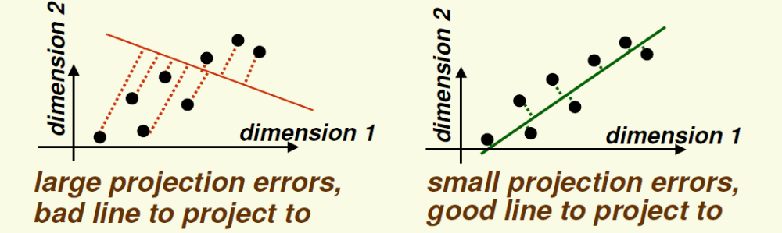
Projection direction
Notice that the good line to use for projection lies in the direction of largest variance

Slide 48
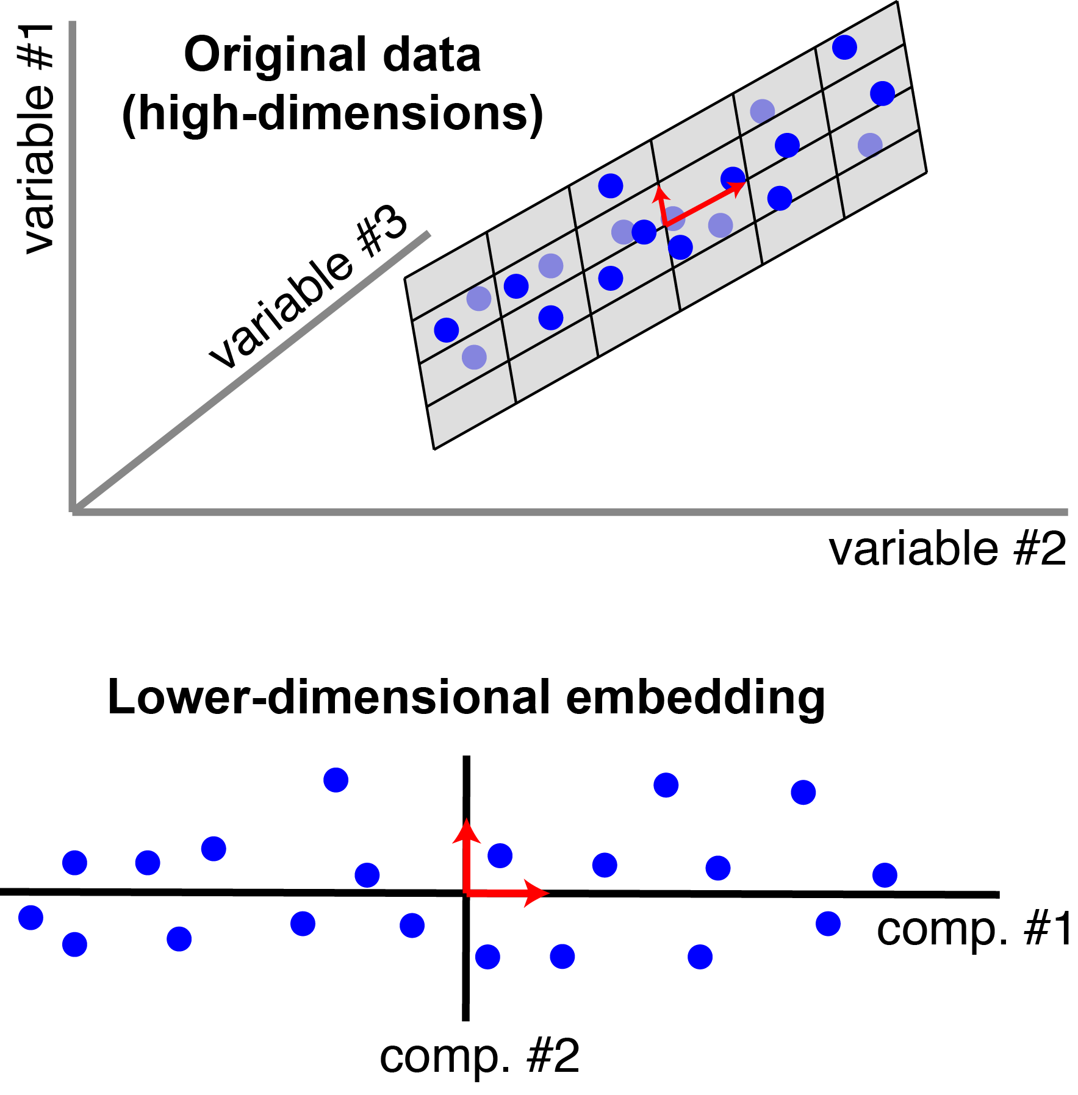
3D PCA Example

Slide 49
The Dissimilarity Measure in PCA
PCA uses Euclidean Distance calculated from the p variables as the measure of dissimilarity among the n objects
PCA derives the best possible k dimensional (k < p) representation of the Euclidean distances among objects.

Slide 50
Example
x <- c(2.5, 0.5, 2.2, 1.9, 3.1, 2.3, 2, 1, 1.5, 1.1)
y <- c(2.4, 0.7, 2.9, 2.2, 3.0, 2.7, 1.6, 1.1, 1.6, 0.9)
df=data.frame(x,y)
plot(x, y, pch = 19)
mean(x);var(x)
mean(y);var(y)
x1 <- x - mean(x)
y1 <- y - mean(y)
plot(x1, y1, pch = 19)
m <-cov(df[,1:2])
e<-eigen(m) # calculate the eigen value
#################################################
principal component vector slopes
s1 = e$vectors[1,1] / e$vectors[2,1] # PC1
s2 = e$vectors[1,2] / e$vectors[2,2] # PC2
plot(x1, y1, asp=T, pch=16, xlab='x', ylab='y')
abline(a=0, b=s1, col='red')
abline(a=0, b=s2)

Slide 51
Example-Contd.
Eigen value and eigen vector
> e <- eigen(m)
> e
An eigenvector is a direction and an eigenvalue is a number that indicates how much variance is in the data in that direction.
The largest eigenvalue is the first principal component; we multiply the standardized values to the first eigenvector, which is stored in e$vectors[,1].

Slide 52
Generalization to p-dimensions
In practice nobody uses PCA with only 2 variables
The algebra for finding principal axes readily generalizes to p variables
PC 1 is the direction of maximum variance in the p-dimensional cloud of points
PC 2 is in the direction of the next highest variance, subject to the constraint that it has zero covariance with PC 1.
PC 3 is in the direction of the next highest variance, subject to the constraint that it has zero covariance with both PC 1 and PC 2 and so on... up to PC p

Slide 53
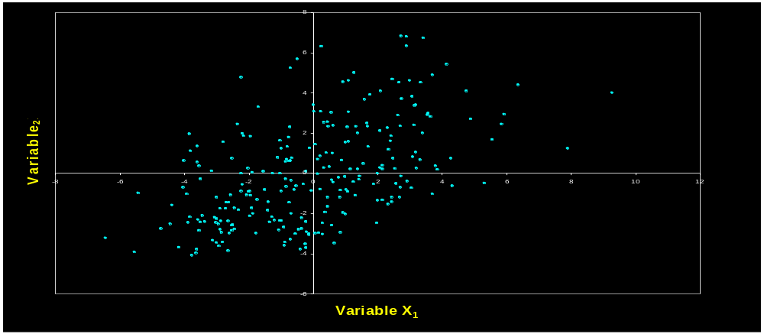
each principal axis is a linear combination of the original two variables
PC_{j} = a_{i1}Y₁ + a_{i2}Y₂ + … a_{in}Y_{n}
a_{ij}’s are the coefficients for factor i, multiplied by the measured value for variable j
PC 1
PC 2

Slide 54
Generalization to p-dimensions
  PC axes are a rigid rotation of the original variables
  PC 1 is simultaneously the direction of maximum variance and a least-squares “line of best fit” (squared distances of points away from PC 1 are minimized).
  if we take the first k principal components, they define the k-dimensional “hyperplane of best fit” to the point cloud of the total variance of all p variables:
  PCs 1 to k represent the maximum possible proportion of that variance that can be displayed in k dimensions
  i.e. the squared Euclidean distances among points calculated from their coordinates on PCs 1 to k are the best possible representation of their squared Euclidean distances in the full p dimensions.

Slide 55
References
Introduction to Data Mining
by Pang-Ning Tan, Michael Steinbach,
Anuj Karpatne and Vipin Kumar

